Slide 1

Lime Case Study 29: Is Bike Sharing the Next Uber?
Danny Huang
Professor Kawalek
BPL 5100 CMWB [29719]
Individual Assignment

Slide 2
Lime Continues to be One of The Largest Leading Global Micro-Mobility Company Through Their Innovations and Strategies
Micro-mobility is on the rise with e-bikes and e-scooters commonly used for short-distance transportation globally. The consumer market for e-bikes and e-scooters are skyrocketing in popularity. Lime was founded by Toby Sun in mid-2017 in San Francisco. They created a name for themselves when they started expanding their products and services throughout the United States and eventually to many countries. They launched its first market in North Carolina after another start-up in 2015, Ofo introduced dockless bikes. They’ve invested $12 million dollars on electric bikes, but soon after, they mainly focused on electric scooters.
Factors that delivered strong performances for the company:
Mainly prioritizing e-scooters and e-bikes.
Operating a sustainable business.
Innovations such as new features of the product
Compliance to policies, regulations, and management of shared active transportation to ensure the safety of the community.
Consistently pivoting through market and consumer demands.
Lime continues to be a micro-mobility giant, while competing with other companies.

Slide 3
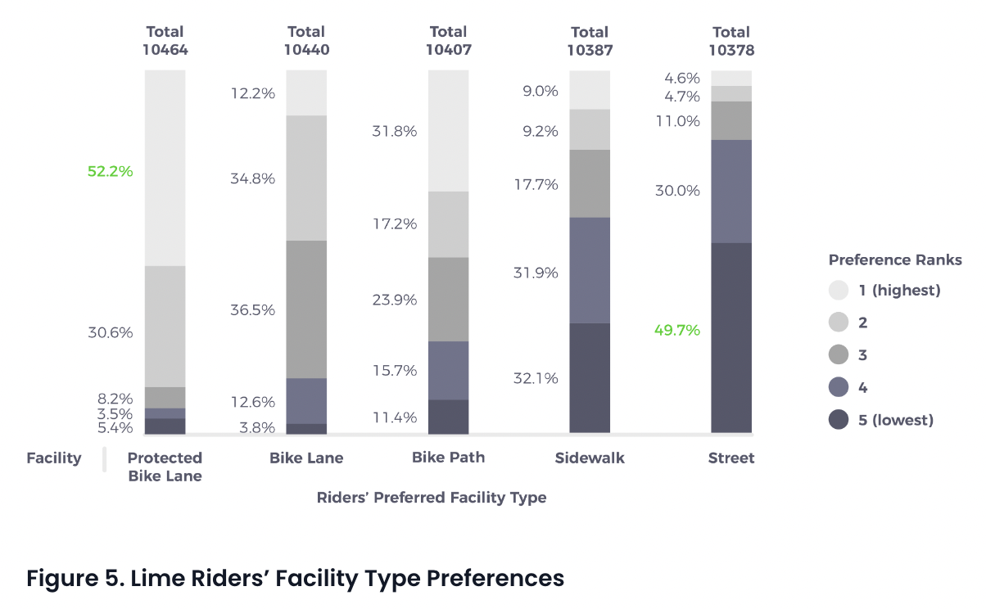
Lime wants to Learn More about Rider’s Habits and Preferences to Improve Micro-Mobility Systems
Automobiles are to be replaced by electric bikes and electric scooters for short commute. Lime’s shared active transportation attracts and encourages new consumers who infrequently ride a bicycle. With Lime’s dockless electric scooters and electric bikes costing $1.00 to unlock and $0.15 per minute of riding, makes commuting very affordable and convenient
Lime riders prefer designated protected infrastructure for electric bikes and scooters, with 52.2% of the rider’s population preferred protected bike lane. Elevating rider safety is Lime’s main priority.

Slide 4
Lime Faced Challenges when they launched as They Shift their Approaches and Take Initiatives to Solving Problems
Lime faced safety concerns along with strained relationships with cities and residents. With shared electric scooters rising in popularity, riders parked scooters carelessly which can block the public space or even trespass other properties. Thus, not only the company’s own scooter can be damaged, but the rider’s lives and physical condition can be affected which Lime can be liable for. Particularly Lime’s products are associated with the public space.
Additionally, Lime faced decision-making dilemmas. They had to lay off 14% of their full time workers due to the challenges to achieve profitability and regulatory challenges. CEO Brad Bao mentioned that when Lime was first founded, the company consisted of a small team and no one can see the future of the company yet. Bao decided to start the company with friends, however realizing it would’ve been better if the company had a more diverse leadership and BOD.
Lime learned from their mistakes. Ben Horowitz said “hire the right people at the right stage.” Lime would’ve been much better with the “right team.” It is unpredictable of whether the start up company will succeed or not. However, gaining more business perspectives, culture, values, and genders are the key to the right success path. Lime found that they did not understand women riders. The entire company can grow if diversified.

Slide 5
Lime Has to Consider External Factors in Order to Succeed in the Micro-Mobility Industry
Political and legal issues that may arise
The national association of city transportation (NACTO) states e-bikes and e-scooters are considered vehicles and should operate under the same policy, provided with guidelines.
e-bikes and e-scooters are subject to theft, vandalism, and fines.
There are no regulations or limits to where to park micro-mobility vehicles in certain countries such as China.
E-bikes and e-scooters requires drivers license and subject to tax and insurance.
What it means for economics
It can cost hundreds of dollars to buy electric scooters and electric bikes. In addition to high maintenance cost that are associated.
Cost associated with repairal fees and licensing can cost up to hundred to thousands of dollars.
Social and technological factors to consider
Electric bikes and scooters are piling up on sidewalks can lead to safety concerns and traffic.
Come up with new innovations to maintain a competitive advantage against competitors such as Mobike, Spin, Jump DC, taxi and Uber industries.
A well developed micro-mobility security system within the app to manage and track each bike and scooters to ensure the safety of their products and the community.
How can the environment affect micro-mobility
Each Company are limited to a certain amount of bikes based on the region.
The severity of the weather can affect the users the ability to travel on the road.
Disposal of scooters and bikes in open areas can ultimately cause sustainable damage which can affect the environment.

Slide 6
Lime Should be Aware of Their Competition and Utilize Their Competitive Advantages
Lime has an excellent cost leadership as they have comparable quality for the affordable prices. For an example, Lime cost $0.15 cents per minute of ride, while Bird cost $0.20 cents per minute of ride. Unlocking the scooter with Lime is much faster and convenient compared to Bird as well.
Lime mainly focused on electric scooters after the popularity of the market skyrocketed. They initially started with electric bikes as the primary product and services. Lime was founded on the simple idea that communities deserves smart and affordable mobility. Additionally, they prioritized user’s safety especially in local routes.
Lime differentiates themselves from their competitors being easily accessible and convenient due to the fact that they have many location sites. Additionally Lime has a color-scheme of green which symbolizes “go”, “to go”, or environmental friendly. Especially Lime runs a sustainable business, they track carbon emission saved with every ride.

Slide 7
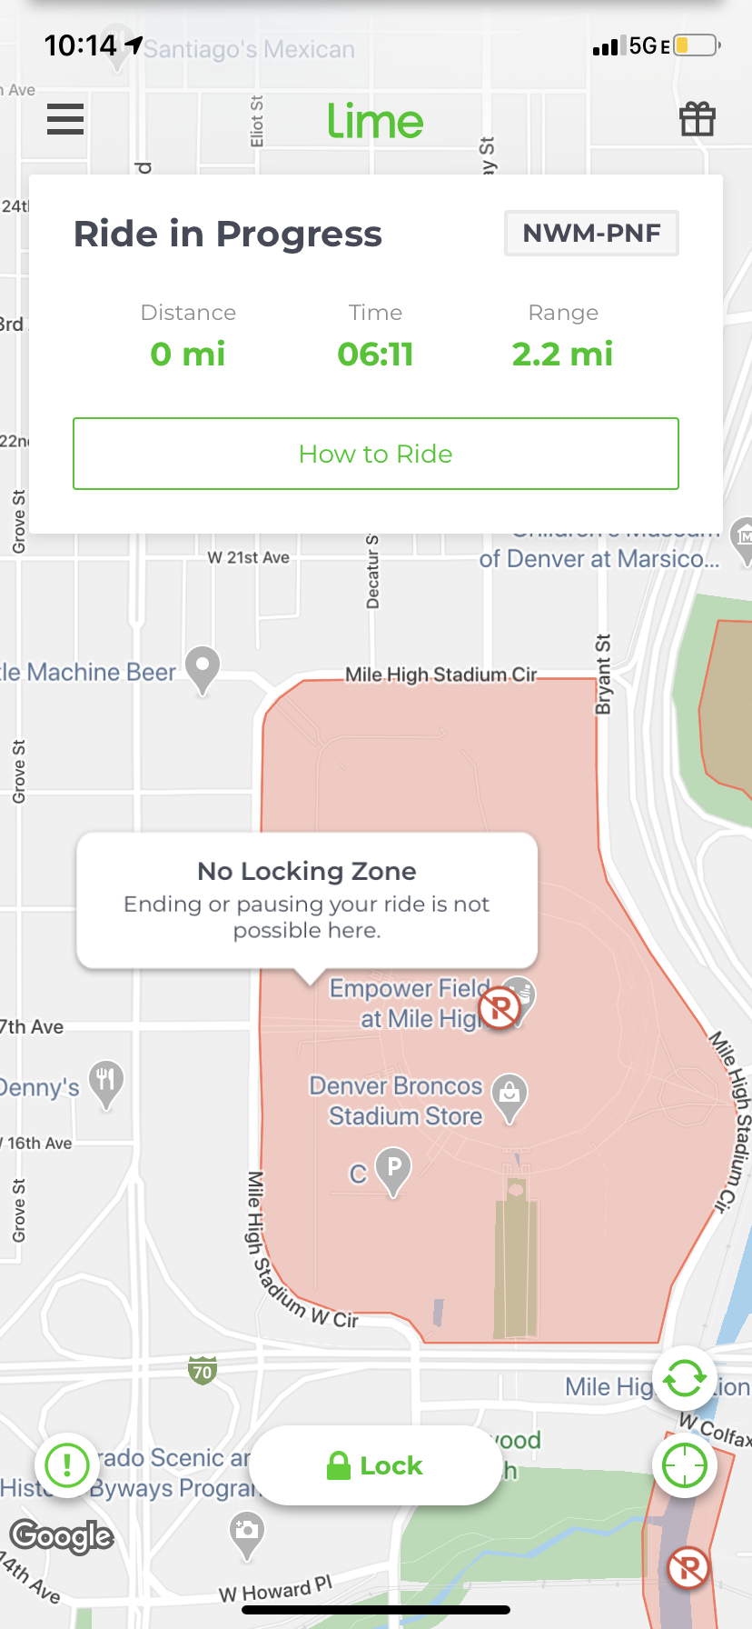
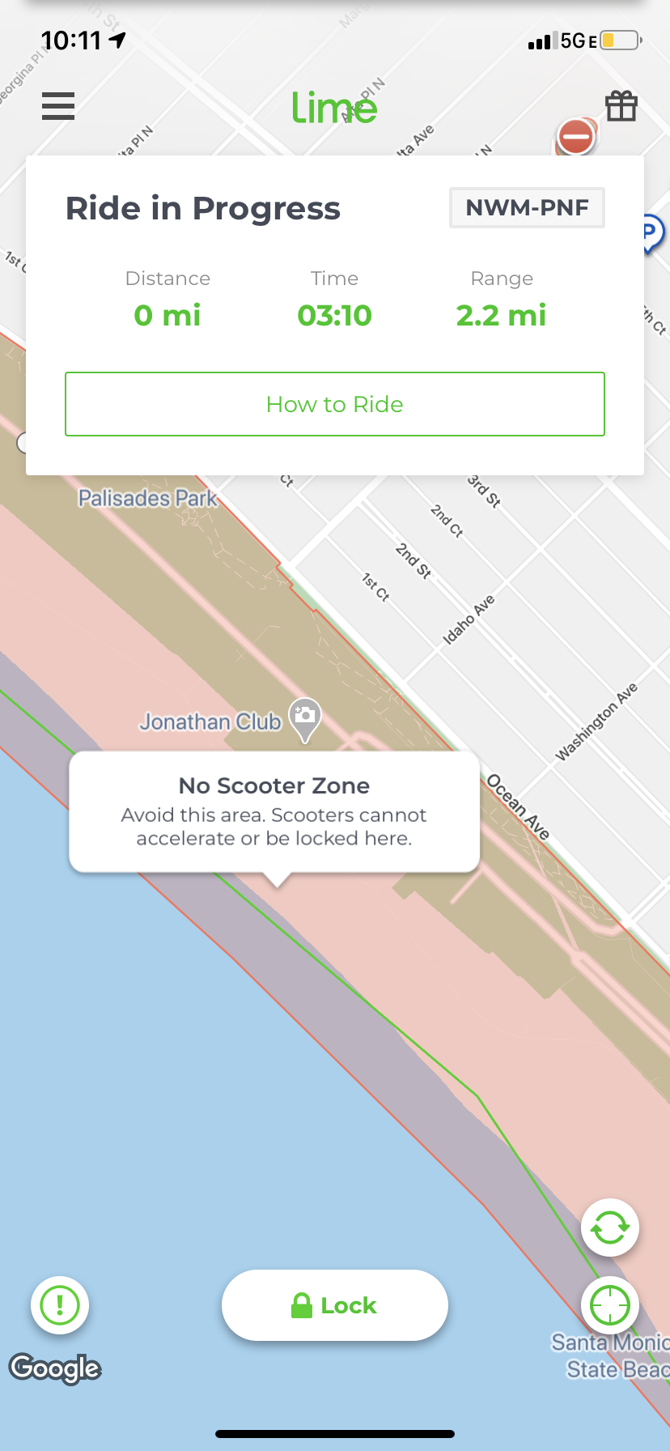
Lime Introduces New Geofencing Technology to Support Communities in Safety and Efficient Micro-Mobility Procedures
Lime took the initiative on developing a new technology to ensure safety travels to address the solutions to the issue. The new technology allows for geofencing zone commands up to 90% faster which sets a record in the micro-mobility industry.
The Lime app shows the users the type of zones which Geofencing and zone detection contains no locking zones, low speed zones, no scooter zones, no parking zones to enforce safety precautions.
The scooter will host all the zone maps.
The electric scooters and bikes will automatically lock after the users completed their ride.

Slide 8
Lime Needs to Take Strategic Actions to Address the Challenges and Accomplish Their Goals
Lime needs to follow the policies and regulations listed by NACTO. Especially Lime’s primary product and services are connected with the public, there are public rules that need to be acknowledged, so that the business does not run into any legal issues.
Lime needs to make sure that their mission and vision statements are aligned with their goals. Their mission and vision is “to build a future where transportation is shared, affordable and carbon-free.” Essentially, they need to build their brand loyalty and brand awareness.
The bike-sharing business needs to understand the market, especially with geographical locations by conducting a market research on different regions of where bikes are located at.
Using frameworks such as PESTLE, SWOT and Porter's 5 Forces analysis to get to know the company and its competitors better.
Lime should conduct interviews and surveys to get to know customers better and take actions on bad reviews to better improve the products and the app.
Additionally, Lime should implement STP (Segmentation, Targeting, and Positioning) strategy for every target market.

Slide 9
Bibliography
“How Moving Quickly Made Lime a Micro-Mobility Giant.” Latana, https://latana.com/post/lime-deep-dive/.
Lime Micromobility | Latest Data Show Lime Attracts New Riders to…. https://www.li.me/it-it/blog/latest-data-lime-attracts-new-riders-reduces-car-use-more.
“Why Lime.” Lime Micromobility, https://www.li.me/why.
McFarland, Matt. “Lime CEO: We Made a Lot of Mistakes and We've Learned from Them | CNN Business.” CNN, Cable News Network, 19 Feb. 2020, https://www.cnn.com/2020/02/19/success/lime-ceo-brad-bao-interview/index.html.
Wadsworth, Jennifer. “Tired of Dodging Scooters? SF Mulls Strict New Rules to Keep Them off Sidewalks.” The San Francisco Standard, 12 Sept. 2022, https://sfstandard.com/transportation/sf-mulls-strict-new-rules-to-keep-scooters-off-sidewalks/.
Matt. “Electric Scooter Rental Guide - Bird, Lime, Sharing Apps, and Everything You Need To Know.” EScooterNerds, 7 Apr. 2022, https://escooternerds.com/electric-scooter-rental-lime-bird/.
“Lime Introduces New Geofencing Technology, Setting Industry Standards...” Lime Micromobility, https://www.li.me/blog/lime-introduces-new-geofencing-technology-setting-industry-standards-for-scooters.

